Slide 1
Weekly Weather
Sibonga Mtambo
ST10445437

Slide 2
Purpose
This app was designed to help people check the weather for a certain day and showscase the weather for each week and also provides the average temperature for that week.

Slide 3
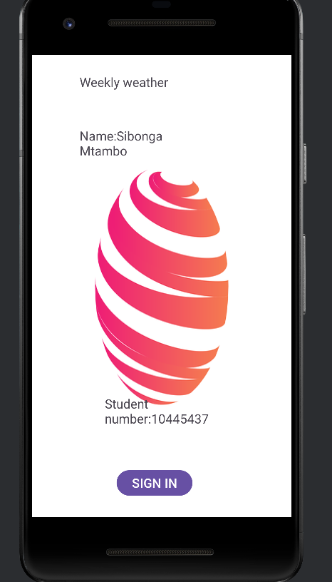
Screenshot 1: This shows the initial screen for when a user enters the app. It also shows the name of the person who made this design and their student I.D

Slide 4
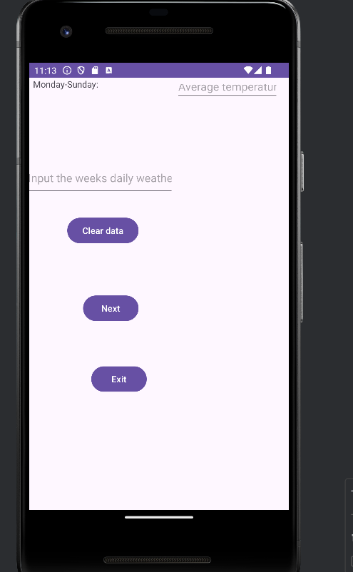
Screenshot2: shows the main screen all the user has to do is input the weather for each day of that week an the app will give the average weather.

Slide 5
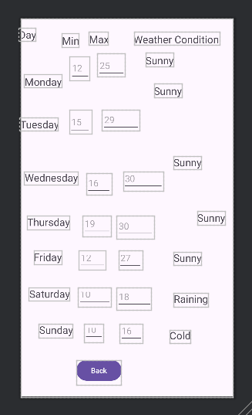
Screenshot3: Shows a more detailed screen.Where the user can see the minimum and maximum temperatures and the weather conditions

